Slide 1

Crime Data Analysis and Visualization using Machine Learning
Mentor: Dr. Samira Zad
Instructor: Dr. Ananda Mondal
Naga Rajitha Bhogapadi - 6384969
Tribhuvan Reddy Kothapally - 6439229
1
Notes:
Hi Team,

Slide 2
Contents
Introduction
Objectives
Proposed Solution
Previous Work
Dataset
Architecture
Algorithms
Implementation
Conclusion
References
2

Slide 3



Introduction
1. Crime impacts quality of life and economy.
2. The project predicts crime trends using FBI data.
3. Analytical & Visual Solution will helps in predicting & highlight crimes
3

Slide 4

Motivation
Crime Hot Spots
Crime Analytics
Helps individuals avoid risky areas and enhance safety.
Enable law enforcement to allocate resources efficiently and prevent crimes.
Data & Society
Combining crime data with demographics fosters safer communities and greater societal well-being.
4

Slide 5




Objectives
Predicting Crime Types
Enhancing Data Visualization
Incorporating Key Factors
Informed Decision Making
5

Slide 6
Previous Work
No comprehensive project has analyzed crime data that covers all city agencies and all states in the U.S.
Prior studies and projects have focused on crime analysis for specific cities, states, or regions but have not been scaled to encompass the entire U.S. or all city agencies.
This project uniquely incorporates data from over 50 states and 7,000 city agencies
6

Slide 7

Proposed Solution
A Visual Interactive Dashboard
It is built using Azure Databricks and Power BI
This dashboard includes variety of filters like crime types, years, state, city, etc.
7

Slide 8
Dataset
The key features are
The data was collected from the FBI-UCR website, a large scale crime data repository.
Total States = 50, City Agencies = 7000+
The data is uploaded to Azure Blob Storage on Azure Cloud
Data set split – Train : Test = 80 : 20
Data points: 40K
Features : 69
Data Period : 2020 to 2023
Key Columns – State Name, Population, Crime Types, Crime Count, Year etc.
8

Slide 9
Dataset(Features)
Numerical /Continuous Features
Population
Total Offenses
Crimes Against Persons
Crimes Against Property
Crimes Against Society
Assault Offenses
Aggravated Assault
Robbery
Homicide Offenses
Murder
Rape
Weapon
Arson
Categorical Features
State
Agency Name/City
9

Slide 10
Architecture
Data Source
Azure Storage
Azure Databricks
Databricks ML
Power BI
10

Slide 11
Approach
We are using Azure, Apache Spark and Python libraries to process the data.
We collect data from FBI services
We will store the data in the Azure Blob Storage.
We will use spark clustering in Azure Databricks to transform and cleanse the data.
We will store the processed data and will process it for analytics through Azure Databricks ML.
Finally, we use Power BI to develop the visualization application where we can see the results of our data.
11

Slide 12
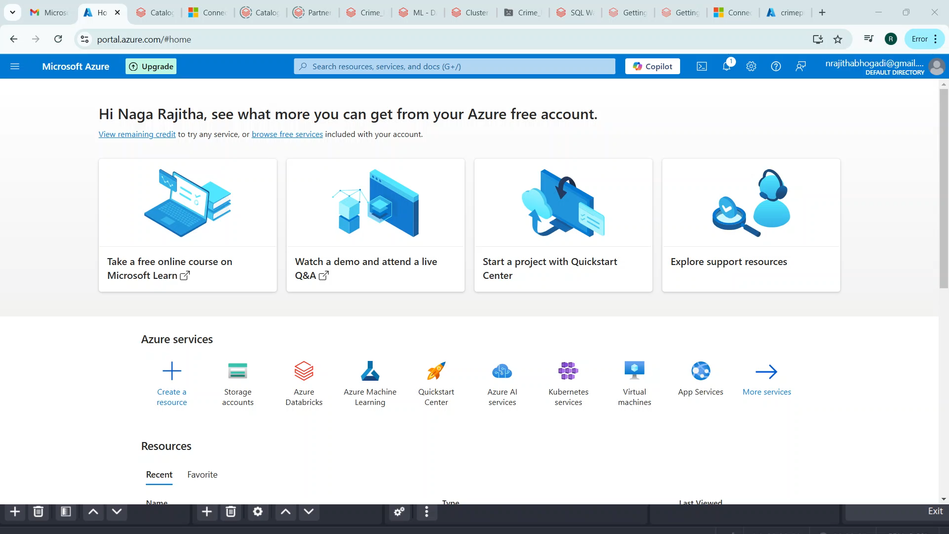
Implementation(Video)
12

Slide 13
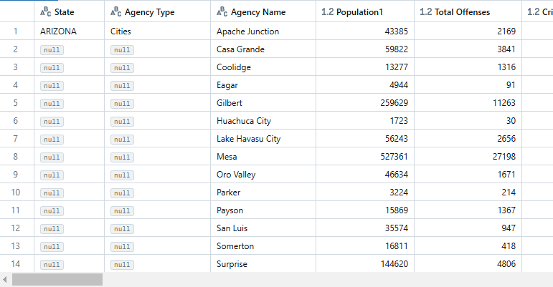
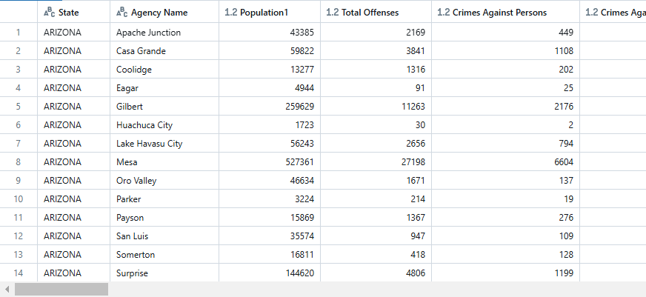
Data Preprocessing
13

Slide 14

Algorithms
Exponential Smoothing Model
Random Forest Classifier
Random Forest Regressor
Ensemble Model
K-means Clustering
14

Slide 15
Target Variables
2024 Total Crime Prediction by State
2025 Total Crime Prediction by State
Top 3 Crimes by City
Most Likely to Occur Crimes Prediction by City
Risk Prediction by City
15

Slide 16
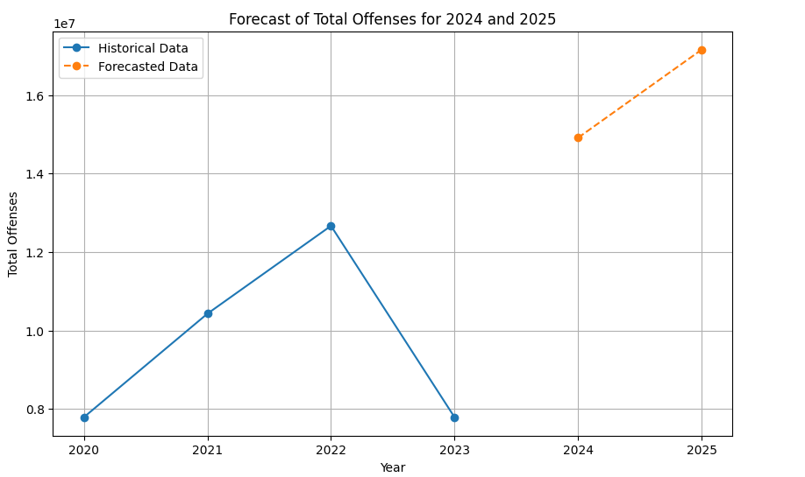
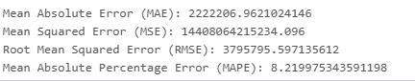
Future Crime Predictions by State and Year
Exponential Smoothing Model
Accuracy: 91.79%
16

Slide 17
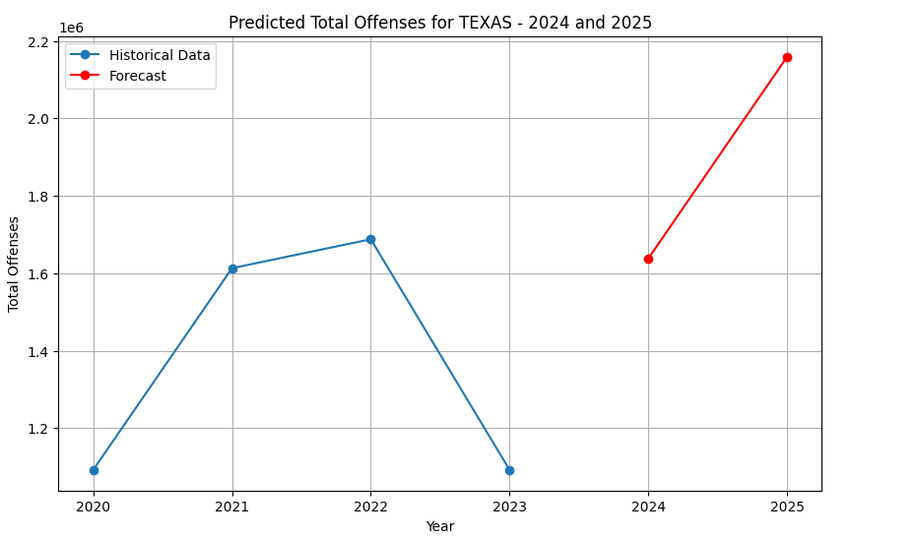
Future Crime Predictions by State and Year
17

Slide 18
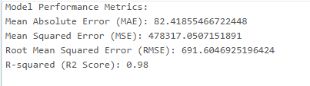
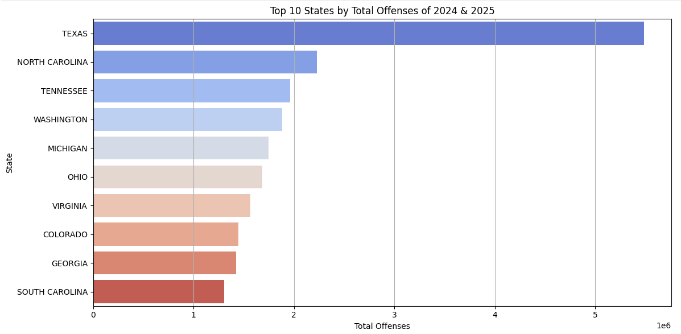
Geographical Distribution of Crimes
Random Forest Regressor
18

Slide 19
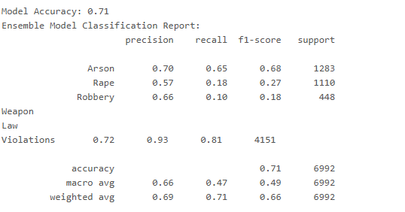
Top Crime Type Prediction
Ensemble Model
RandomForestClassifier
GradientBoostingClassifier
XGB Classifier
19

Slide 20
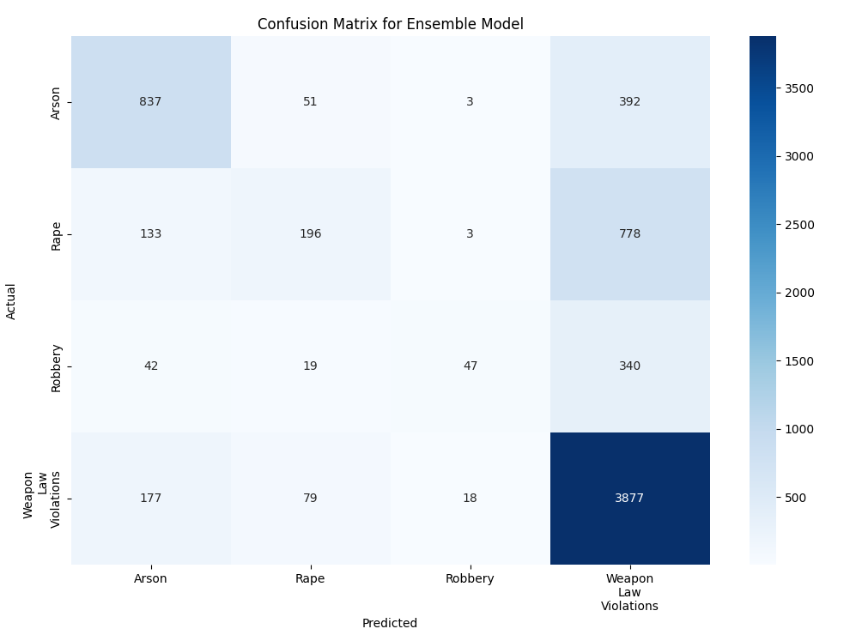
Top Crime Type Prediction
20

Slide 21
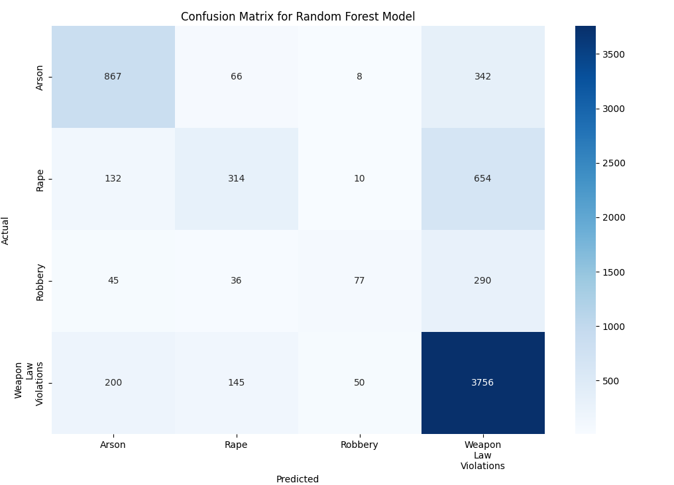
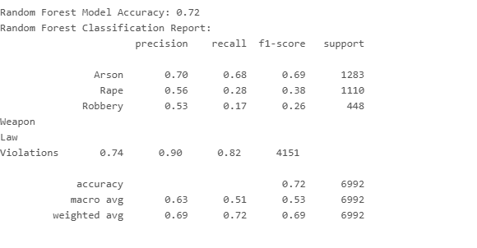
Top Crime Type Prediction
Random Forest Classifier
21

Slide 22
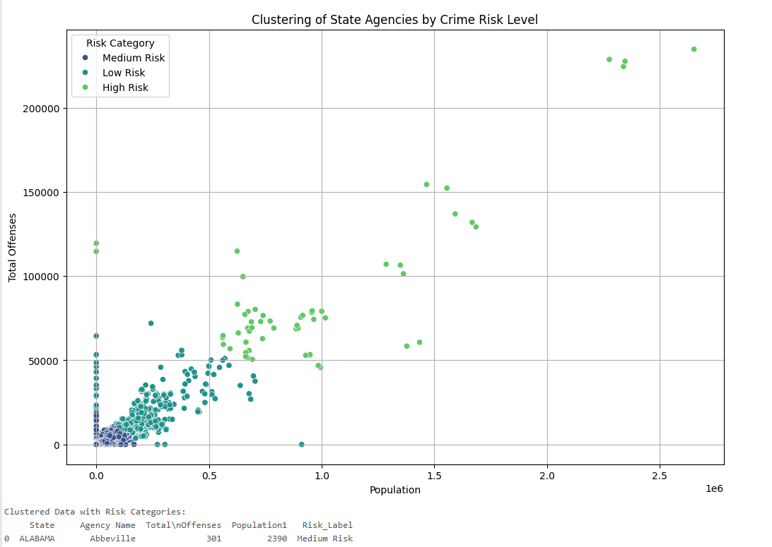
Future Crime Hotspot Identification:
K-Means Clustering Algorithm
Categorizes crime risk level
Targeted resource allocation
Strategic decision making
22

Slide 23
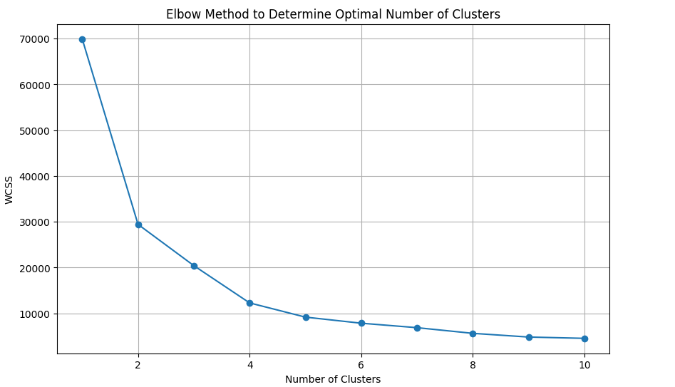
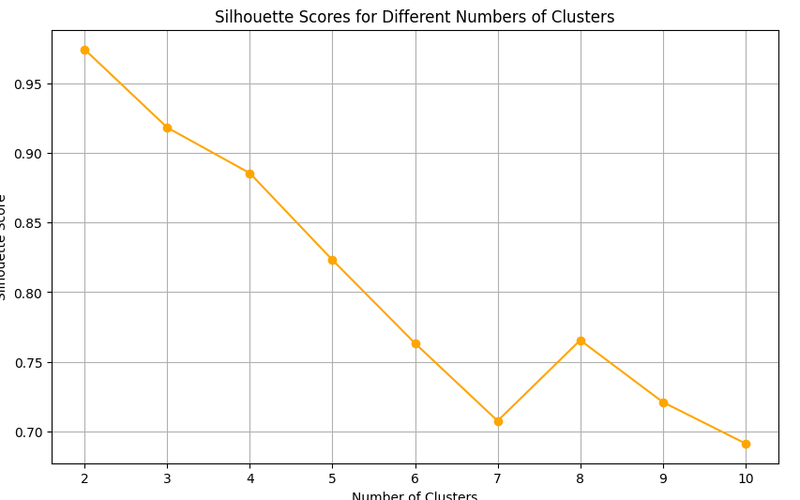
Future Crime Hotspot Identification:
23

Slide 24
Future Crime Hotspot Identification:
K-Means Clustering Algorithm
Categorizes crime risk level
Targeted resource allocation
Strategic decision making
24

Slide 25
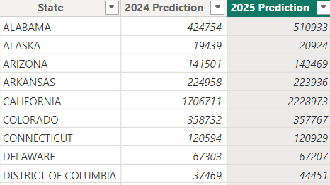
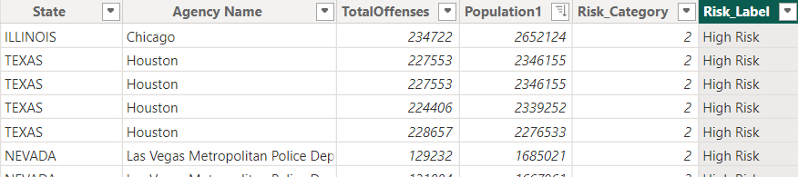
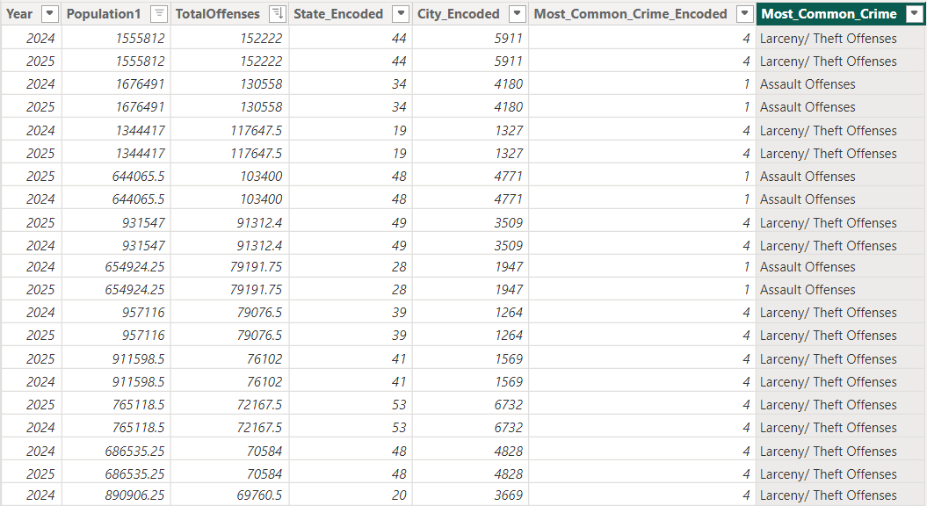
ML Model Generated Datasets
25

Slide 26
Power BI
The Power BI is a data visualization tool used to build interactive visual reports and dashboards.
Using Power BI, the following were created
Crime Data Visualization on a hotspots map
Crime Distribution visuals
Crime Table
26

Slide 27
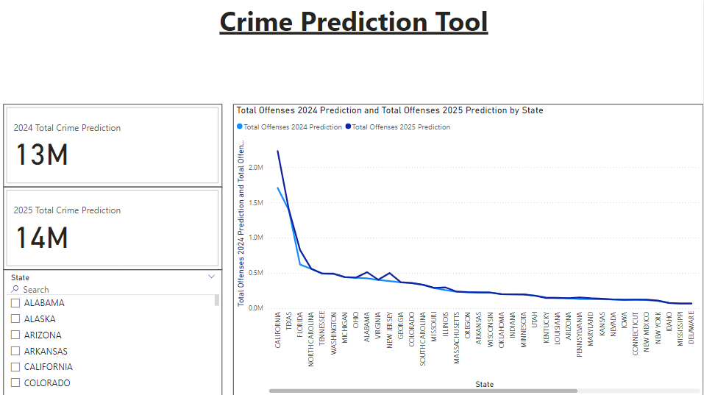
Crime Data Visualization on a hotspots map
Interactive dashboard to monitor the future crime
27

Slide 28
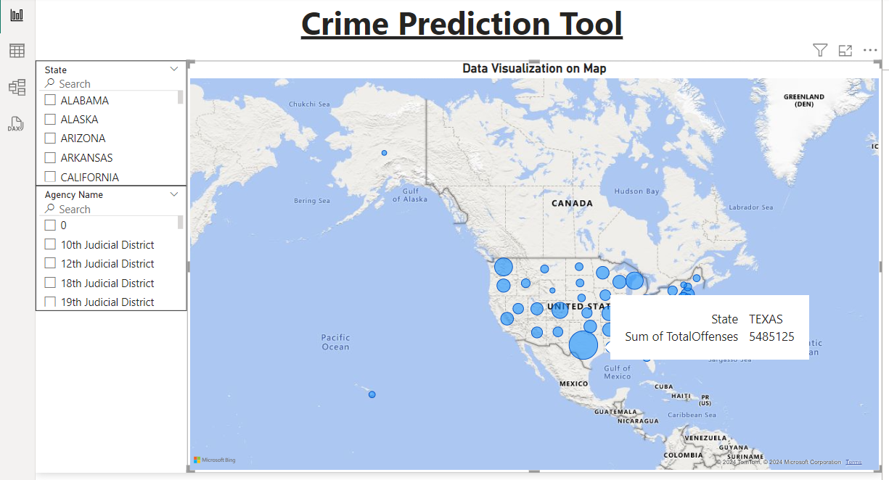
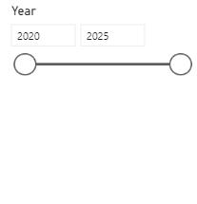
Crime Data Visualization on a hotspots map
Interactive dashboard to monitor the crime
28

Slide 29
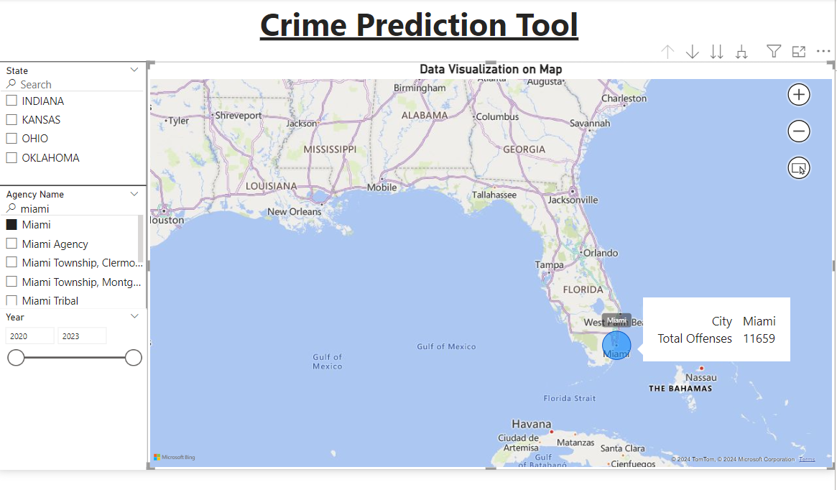
Crime Data Visualization on a hotspots map
29

Slide 30
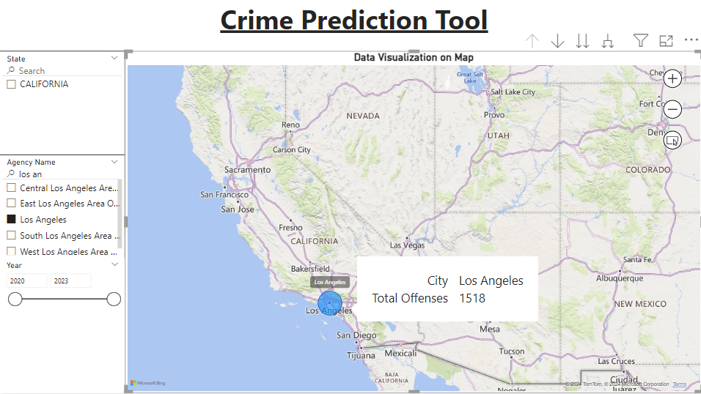
Crime Data Visualization on a hotspots map
30

Slide 31
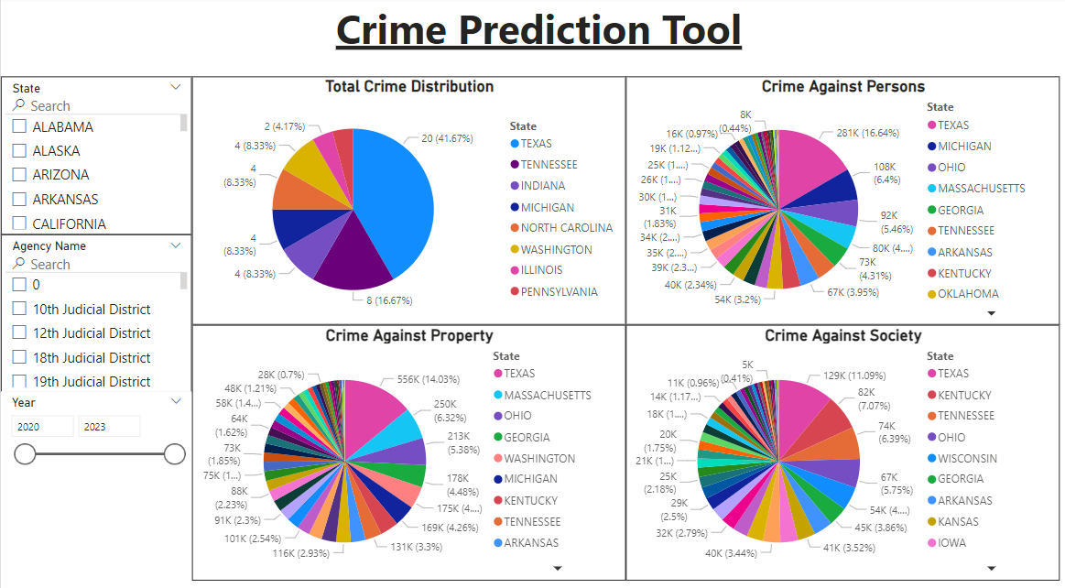
Crime Distribution visuals
31

Slide 32
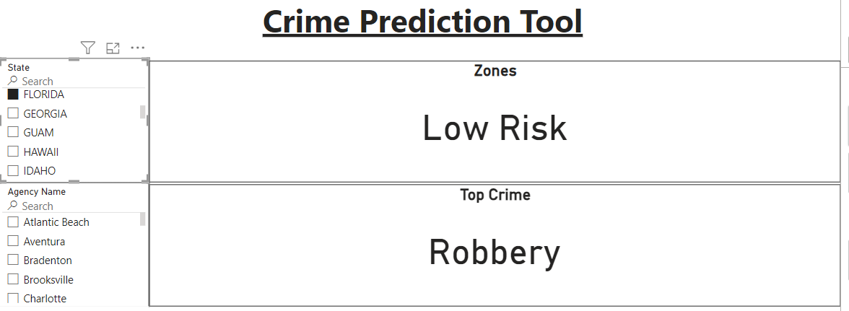
Crime Risk Areas
32

Slide 33
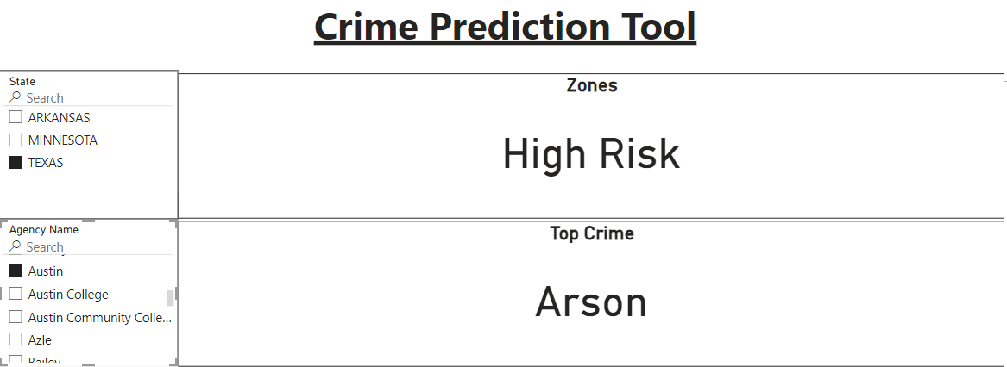
Crime Risk Areas
33

Slide 34
Conclusion
Successfully implemented machine learning to analyze and predict crime trends in the U.S. using data from 2020 to 2023.
Utilized Azure Databricks for data processing and Power BI for visualizing results.
Developed models like Random Forest Classifier, Ensemble methods, and K-Means clustering to predict crime trends and categorize risk.
Provided tools for identifying high-crime areas and supporting resource allocation.
34

Slide 35
Future Work
Integrate socioeconomic data (e.g., unemployment rates, income levels) for better predictive accuracy.
Implement real-time data integration for ongoing crime monitoring and forecasting.
Expand to include broader data sources, such as local agency reports and social media analytics.
Explore deep learning models for enhanced prediction and classification capabilities.
35

Slide 36
References
https://www.researchgate.net/publication/302026832_Using_Big_Data_Analytics_for_developing_Crime_Predictive_Model
https://dl.acm.org/doi/abs/10.1145/3523089.3523094
https://www.jetir.org/papers/JETIR2107201.pdf
https://iopscience.iop.org/article/10.1088/1742-6596/1916/1/012168/pdf
36

Slide 37
Thank You

